Slide 1


JavaScript Operators
Nagaraju Katta

Slide 2


Today’s Agenda
Operators
Unary operators
Assignment operators
Comparison operators
Logical operators

Slide 3
Operators
Unary operators
Assignment operators
Comparison operators
Logical operators

Slide 4
Unary Operators
The simplest operators in JavaScript are unary operators
A unary operator works on one operand
The unary operators in JavaScript are:
Unary plus ( + ) : convert an operand into a number
Unary minus ( - ) : convert an operand into a number and negate the value after that
Prefix / postfix increments ( ++ ) : add one to its operand
Prefix / postfix decrements ( -- ) : subtracts one from its operand

Slide 5
Assignment Operators
An assignment operator assigns a value of the right operand to its left operand
The basic assignment operator is equal ( = )
E.g : let a = 10;

Slide 6
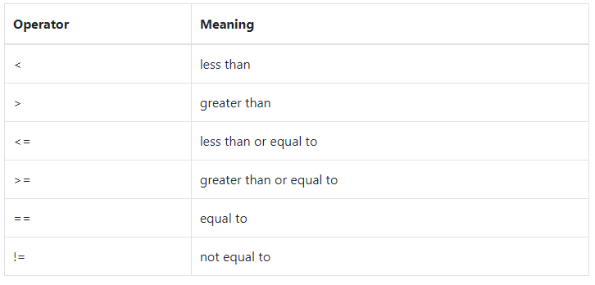
Comparison Operators
To compare two values, you use the comparison operators.
A comparison operator returns a Boolean value indicating that the comparison is true or false

Slide 7
Strict equal ( === ) and not strict equal (!==)
The strict equal and not strict equal operators behave like the equal and not equal operator except that they don’t convert operand before comparison

Slide 8
Logical Operators
The logical operators are important in JavaScript because they allow you to compare variables and do something based on the result of that comparison
For example, if the result of the comparison is true, you perform a block of code; if it’s false, you perform another block of code.
! ( Logical NOT)
|| ( Logical OR)
&& ( Logical AND)

